Slide 1

Testing Web Services Java Based Solution
www.pragmatic.bg
Lector: Dimitar Topuzov
E-mail: dtopuzov@gmail.com
LinkedIn: http://bg.linkedin.com/pub/dimitar-topuzov/18/470/833/en
Copyright © Pragmatic LLC 2015

Slide 2
Content
Approaches for Multitier Software Automation
Test Driven Development
Behavior Driven Development
How to start with automation of Multitier Software
Selecting programing language
Selection APIs for UI and Service Layer
(Optional) Think about BDD

Slide 3
Multitier Architecture
UI Layer
Presentation
Service Layer
Business logic
DB Layer
Data storage

Slide 4
Multitier Architecture
UI Layer
Service Layer
How to test it?
DB Layer

Slide 5

Testing Service Layer
Benefits:
Good way to test business logic
Faster tests
Less fragile
Lower Maintenance
Disadvantages:
Not testing what user actually use and see
UI Layer
Service Layer
DB Layer

Slide 6

Testing UI Layer
Benefits:
Test what user see
Disadvantages:
Slower
More Fragile
Higher Maintenance Cost
UI Layer
Service Layer
DB Layer

Slide 7
Testing Both Layers (1)
Benefits:
Test both Service and UI Layer
Disadvantages:
No reuse of code, build and CI infrastructure, reporting tools, etc.
UI Layer
Service Layer
DB Layer

Slide 8

Testing Both Layers (2)
Benefits:
Single Code Base
Reuse Code, CI infrastructure, reporting tools, etc
Disadvantages:
Might be a bit hard to setup for first time
UI Layer
Service Layer
DB Layer

Slide 9
Testing Service Layer
Benefits:
Single Code Base
Reuse Code, CI infrastructure, reporting tools, etc
Disadvantages:
Might be a bit hard to setup for first time
UI Layer
Service Layer
DB Layer

Slide 10
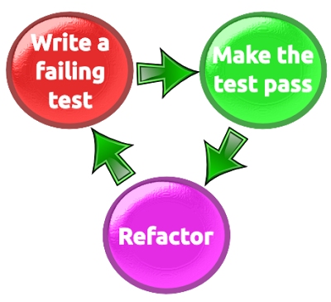
Let’s Talk About Development Practices
Test Driven Development

Slide 11
Something Went Wrong
Test Driven Development On Practice
Usually TDD = Unit tests written from developer for his/her own code
Usually result in “confirmation that the system does what it does”

Slide 12
Bike Example
Let’s write some tests that test a bike
Verify pedals are available
Verify breaks are available
Verify seat is available
Verify bike has two tires

Slide 13

Bike Example
Let’s write some tests that test a bike
Verify pedals are available
Verify breaks are available
Verify seat is available
Verify bike has two tires

Slide 14
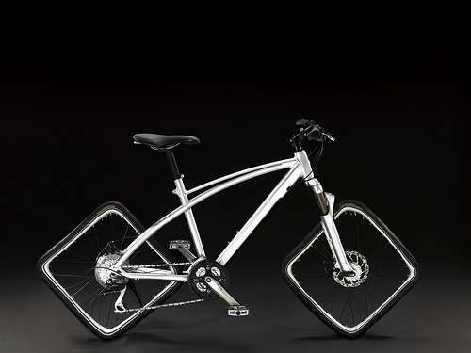
Bike Example
Is it a Bike?
Pedals
Breaks
Seat
Two Tires

Slide 15
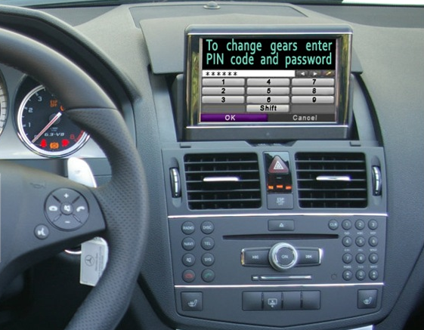
Useless Car Example

Slide 16

The Problem
What happened?
ITs are not Domain Experts
Domain Experts don’t know the technology

Slide 17
The Solution
How to solve the problem?
Make sure Acceptance Criteria is defined by Domain Experts
Make sure Domain Experts and ITs talk the same language
Make sure you have Single Source of Truth
Illustrate requirements using examples
Automate those examples

Slide 18

Behavior Specifications
Title (one line describing the story)
Narrative:
As a [role]
I want [feature]
So that [benefit]
Acceptance Criteria: (presented as Scenarios)
Scenario 1: Title
Given [context]
And [some more context]...
When [event]
Then [outcome]
And [another outcome]...
Scenario 2: ...

Slide 19
Scenario Example
Scenario: Divide by zero
Given clean calculator
When press 1
And press divide button
And press 0
And press equal button
Then the result should be
Cannot divide by zero

Slide 20
Bad Scenario Example
Scenario: Divide by zero
Given calculator.exe is started
When click button with id=Btn1
And click button with id=BtnDevide
And click button with id=Btn1
And click button with id=BtnEqual
Then text box with name=Result contains Cannot divide by zero text

Slide 21
How to Write Scenarios
Don't specify business rules...
...but key business examples
Customer can easily read and understand them
Features should only contain information that the user sees
Step description should never contain regexes, CSS or XPath selectors, any kind of code or data structure

Slide 22
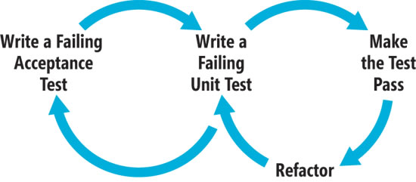
Behavior Driven Development
Based on TDD
Focusses on behavior of the product

Slide 23
BDD Tools
BDD Tool | Specifications Format | Implements Gherkin | Platforms
Specflow | Plain text | Yes | .NET
Cucumber | Plain text | Yes | Ruby
Cucumber-JVM | Plain text | Yes | Java and JVM languages
Jbehave | Plain text | Yes | Java
Rspec | BDD like API | No | Ruby
Concordion | Html | No | Java, .NET, Python, Scala, Ruby

Slide 24
To BDD or NOT to BDD
To BDD or NOT to BDD
…it is a topic for a beer discussion
Note that using BDD tools != Follow BDD as Process
Sometimes we might use only the tools just because they give us some benefits

Slide 25
Single Code Base Solution
How to Start
Pick up programing language
Based on ecosystem already adopted in company/project
Based on what APIs for UI and Service Layer are available for this language
Based on your knowledge and experience
Based on popularity
Popular Options: Java, C#, Python, JavaScript, Ruby

Slide 26
Single Code Base Solution
How to Start
Pick libraries for UI Layer
Based on selected programming language
Based on what is the UI
Based on popularity

Slide 27
Single Code Base Solution
Popular UI Layer Testing Libraries
Web Testing
Selenium WebDriver
Telerik Testing Framework
Mobile (Native Apps)
Appium
Selendroid
Calabash
Windows Desktop
White, Windows UI Automation, Telerik Testing Framework
Image based APIs
Sikuli

Slide 28
Single Code Base Solution
Popular Service Layer Testing Libraries
Java
Rest-assured (see this Simple Project)
Jersey
Axis (for SOAP Services)
.NET
HTTP Client
Json.NET
Sample Project

Slide 29

Why Java?

Slide 30
Why Java?
Benefits
Large Adoption
Good Libs for both UI and Service Testing
Cross-platform (can execute the solution on Windows, Linux and OSX)

Slide 31
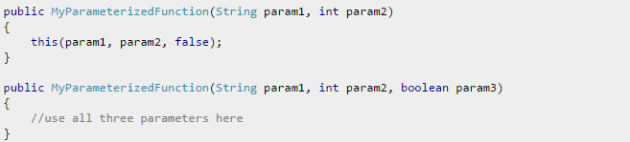
Why Java?
Disadvantages
No support for default arguments
This is how Java works

Slide 32
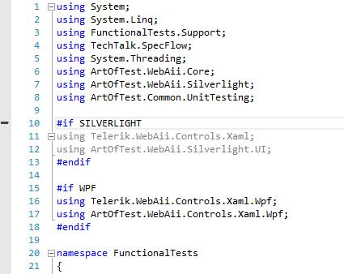
Why Java?
Disadvantages
Problems with UIMaps for cross-platform apps
No conditional compilation

Slide 33
Demo Prerequisites
Maven
What is maven
Download from here (apache-maven-3.3.9-bin.zip) and extract it folder of your choice
Add environment variable M3_HOME and add %M3_HOME%\bin to PATH
JDK 1.8+
Eclipse or any other Java IDE

Slide 34
Junit
What is Junit
JUnit is a unit testing framework for the Java Programming Language.
Features
Open source framework used for writing & running tests
Provides Annotation to identify the test methods.
Provides Assertions for testing expected results.
Provides Test runners for running tests.

Slide 35
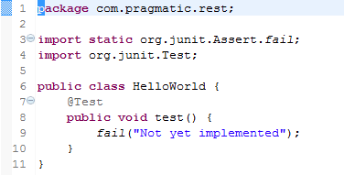

Junit TestCase
Simple Junit TestCase (method with @Test annotation)
Ignore Tests (use @Ignore annotation)

Slide 36
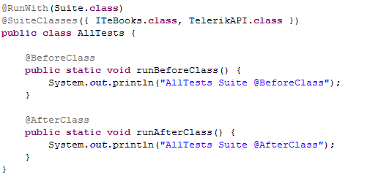
Junit TestSuite

Slide 37
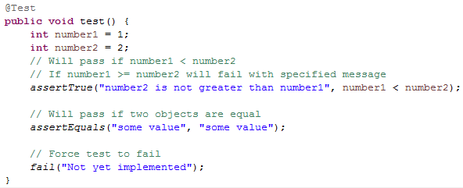
Junit Asserts

Slide 38
Junit Hooks
Junit Hooks (optional)
BeforeCass
Executed before all tests in class
AfterClass
Executed after all tests in class
After
After each test
Before
Before each test

Slide 39
REST Assured
What is REST Assured
Testing and validation of REST services in Java is harder than in dynamic languages such as Ruby and Groovy.
REST Assured brings the simplicity of using these languages into the Java domain.
Resources
Web Site: http://rest-assured.io/
GitHub Repo: https://github.com/rest-assured/rest-assured
Wikis: https://github.com/rest-assured/rest-assured/wiki
3.0.0 Release Notes
Getting Started (up to date with 3.0.0)

Slide 40
REST Assured Features
Support for HTTP methods
GET, POST, PUT, …
Support for BDD / Gherkin (Given/When/Then)
given/when/then DSL out of the box
Can also integrate with Cucumber JVM
Use of Hamcrest matchers for checks
equalTo
hasItem
Use of GPath for selecting elements from JSON response
GPath is Groovy expression language which allows parts of nested structured data to be identified

Slide 41

REST Getting Started
Static imports
In order to use REST assured effectively it's recommended to statically import methods from the following classes:

Slide 42
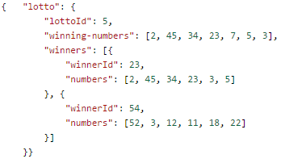
REST Getting Started
Simple Test
get("/lotto").then().body("lotto.lottoId", equalTo(5));

Slide 43
REST Getting Started
Another Test
get("/lotto").then().body("lotto.winners.winnerId", hasItems(23, 54));

Slide 44
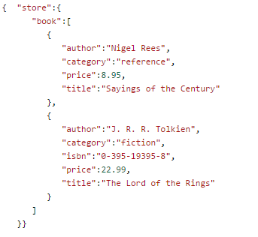
REST Getting Started
when().get("/store").
then().
body("store.book.findAll { it.price < 10 }.title", hasItems("Sayings of the Century"));

Slide 45
REST Getting Started
Send Requests
Add Parameters
Add Headers
given().
param("x", "y").
header("z", "w").
when().
get("/something").
then().
statusCode(200).
body("x.y", equalTo("z"));

Slide 46
REST Getting Started
Extract values after validation
String id =
when()
.get(baseURL + "book/{id}", "2279690981")
.then()
.statusCode(200)
.extract()
.path("ID").toString();
Assert.assertEquals("Id is not correct", "2279690981", id);

Slide 47

Questions

